Slide 1
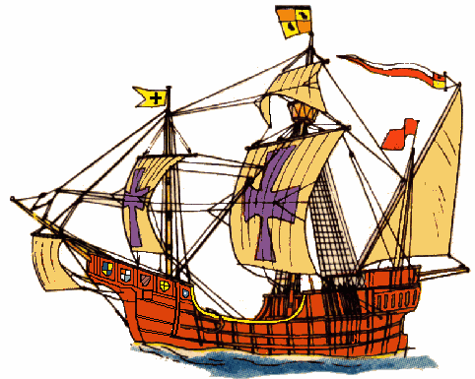
Reasons for Exploration
Find new routes to Asia.
Learn more about geography.
Claim Land
Spread Christianity
Establish trading outposts

Slide 2
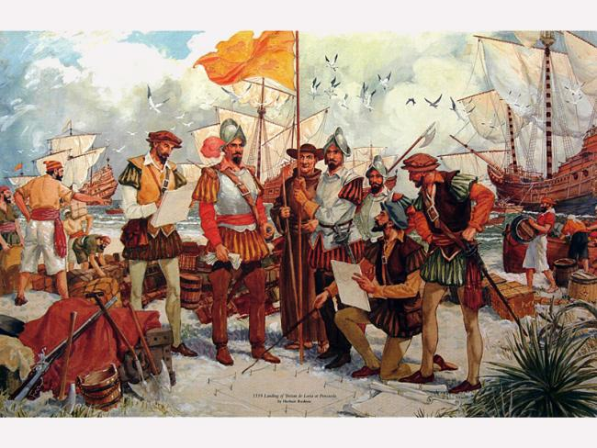
Impact of Exploration
SPAIN
Changed people’s view of the world.
Discovery that circumnavigation was possible - earth is round!
Discovered the Americas
Found a westward route to the Indies.
Settled the West Indies
Spain earned great wealth from its settlements
Settlers mined for precious minerals and started sugar plantations.
Beginning of the Columbian Exchange

Slide 3
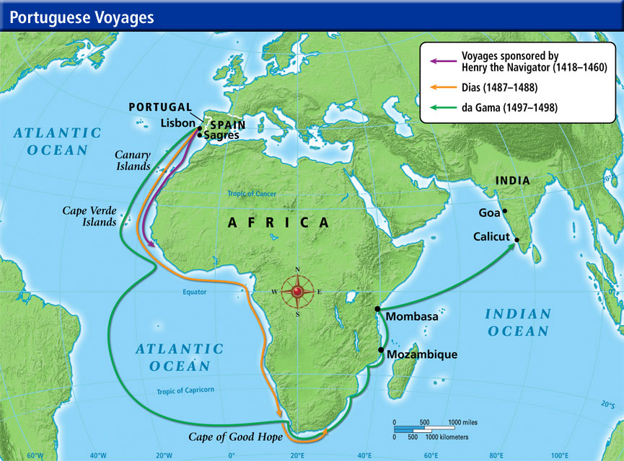
Portugal
Impact of
Exploration
Found a sea route to the Indies (Vasco Da Gama)
Brought back spices and goods such as incense, jewels and silk.
Broke the hold of the Muslim and Italian dominance of Asian trade.
Established colonies in Brazil.

Slide 4
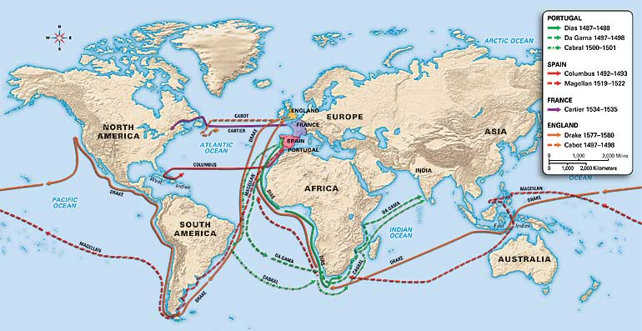
European Exploration

Slide 5
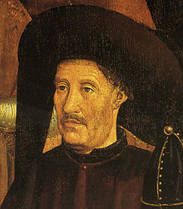
The Age of Exploration
It all began with “Prince Henry the Navigator.”
What About Henry?
Born in 4 March 1394 in Porto, Kingdom of Portugal
3rd son of John I of Portugal and Philippa of Lancaster
Died 13 November 1460
Place of death-Sagres, Kingdom of the Algarve

Slide 6
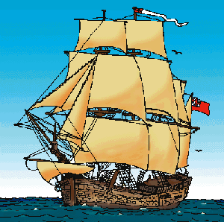
Henry as “The Navigator”
Henry never journeyed the sea
Henry organized expeditions
of sailors to explore the western
coast of Africa
In 1416, Henry founded the
School of Navigation in Sagres,
at the southwestern tip
of Portugal

Slide 7
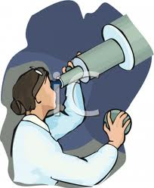
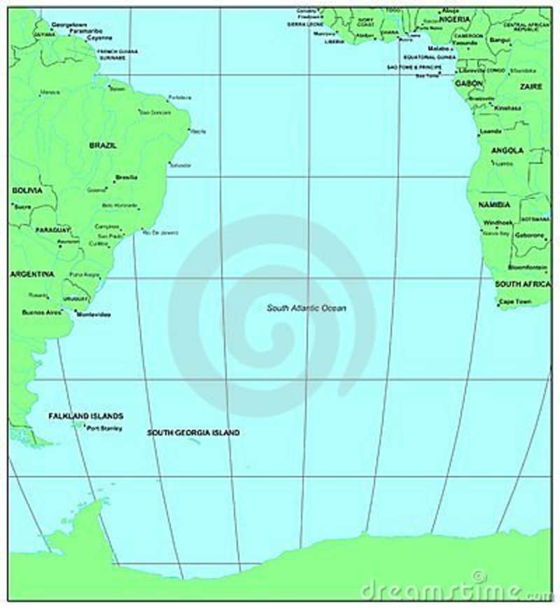
Henry as “The Navigator” Continued
Astronomers, geographers
and mathematicians study
and teach new methods of
navigation and traveling the seas
Expeditions were planned
using the latest maps, tools
and information about wind
currents in the Atlantic Ocean

Slide 8
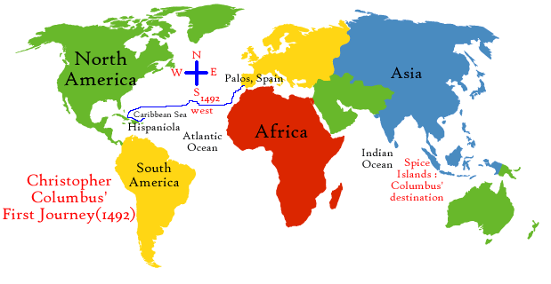
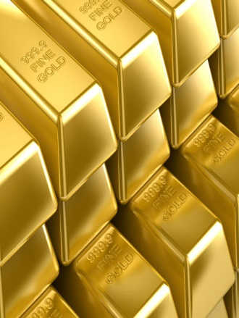


Christopher Columbus-Where was He Going?
Columbus asked for permission from Monarch’s in Spain and Portugal to sail to the far east to look for trade routes to the west
In 1492, Queen Isabella and King Ferdinand of Spain granted his request
Columbus promised to bring back gold, spices and silk from Asia
Columbus also promised to spread Christianity and to explore China
He also requested to be the Governor of the lands he discovered

Slide 9
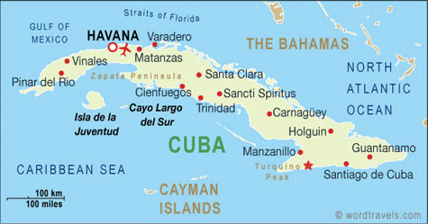
Columbus and the Nina, the Pinta and the Santa Maria
Columbus set sail on
August 3, 1492 and hit
land on October 12, 1492
Thinking that it was Asia,
Columbus named it
San Salvador
He continued on his journey to find China and ended up in Cuba.
Columbus still never found the “riches” he was looking for

Slide 10
Columbus’s Remaining Voyages
On November 3, 1493, Columbus thought he had found the islands of Japan
The islands were Dominica, Guadeloupe and Jamaica
Columbus still found no riches and continued on his quest for Spain
On July 31, 1498, Columbus discovered Trinidad and Tobago, Grenada and Margarita
He also reached the South American mainland

Slide 11
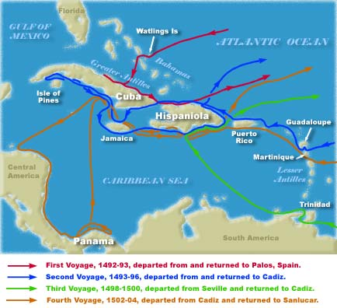
The End of the Voyage and Columbus’s Legacy
In 1502, Columbus would discover the following places (Central America and Panama)
Columbus Day is celebrated in the United States each year on the 2nd Monday in October
His major contribution and what he is often remembered for is that he was the first to visit, settle and stay in these lands for a period of time

Slide 12
Brainpop!
Christopher Columbus
http://www.brainpop.com/socialstudies/famoushistoricalfigures/christophercolumbus/

Slide 13
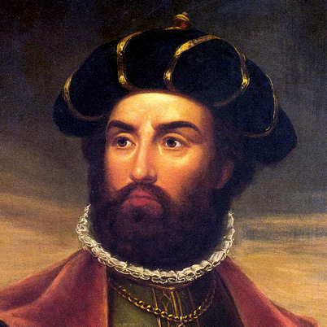
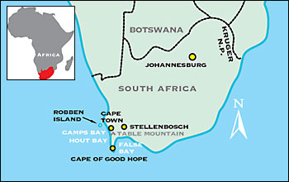
…Vasco Da Gama
Born into a noble Portuguese family in 1460.
Joined the Navy when he was older and learned about navigation.
In 1497, he was commissioned by King Manuel of Portugal to find a route directly to India from Portugal.
He was the 1st person to sail directly from Europe to India.
In May, 1498, he reached the Indian coast – after rounding the Cape of Good Hope.
In 1487 Bartolomeu Dias was the first explorer to round the Cape of Good Hope in Southern Africa.
Showed that the Atlantic and Indian Oceans were connected

Slide 14
The Voyages of Amerigo Vespucci
Portuguese explorer who claimed Brazil for Portugal in 1500.
On his 3rd and most successful voyage, he discovered Rio de Janeiro and Rio de la plata in Brazil.
Vespucci believed he had discovered a new continent (South America) and called it the New World.
In 1507, America was named after Amerigo Vespucci.

Slide 15
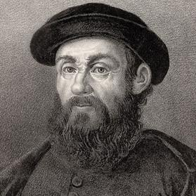
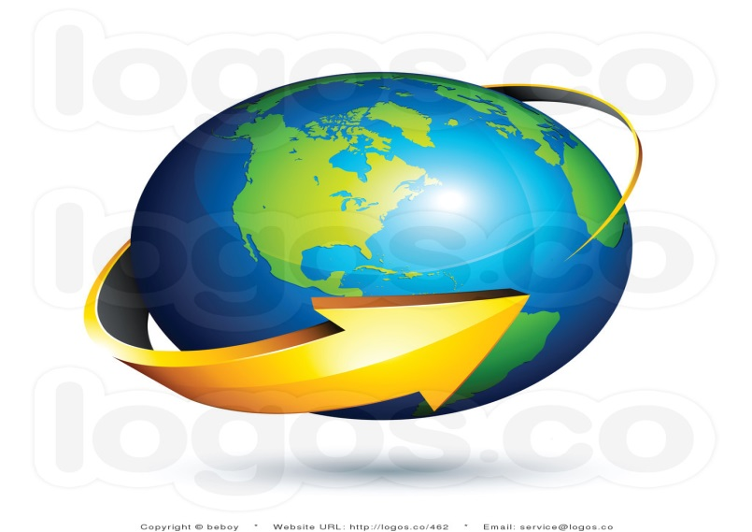
Ferdinand Magellan
Born c. 1480 in Sabrosa, Portugal
Died April 27, 1521 in Mactan, Philippines
Magellan, who was Portuguese but served Spain, led the first European voyage to circumnavigate the globe
Portugal was no longer willing to employ him after he was falsely accused of trading with the Moors
Magellan moved to Seville, Spain in 1517 to offer his navigational services to King Charles V
Magellan’s voyages proved once and for all that the Earth was Round

Slide 16
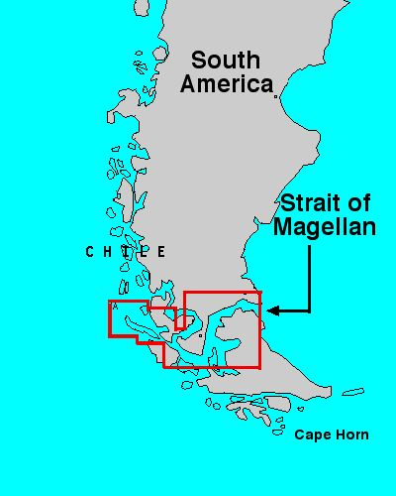
Magellan…The Final Years
Voyage to “circumnavigate” the globe began on September 20, 1519 (To go completely around especially by water)
October 1520, the fleet of ships entered what is today called the “Strait of Magellan”
The voyage through the Strait of Magellan took about one month

Slide 17
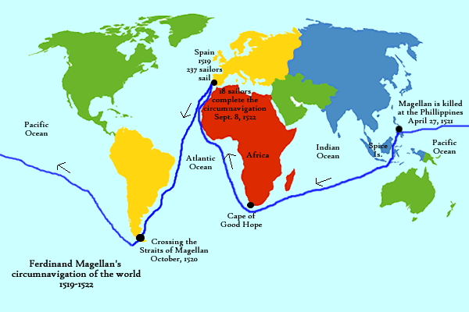
Circling the Globe…Finally

Slide 18
Effects of Portuguese Exploration on Indigenous (native) populations
Portugal established colonies in Brazil.
Portuguese tried to make native people give up their religion and convert to Christianity.
Forced natives to work on sugar plantations.
Large portion of native population died from overwork and European diseases.
Many natives fled to the interior of Brazil.
Colonization of Brazil impacted Africa. As the native population of Brazil decreased, the Portuguese needed more workers. Starting in the mid 1500s, they brought millions of enslaved West Africans to Brazil.

Slide 19
Effects of Spanish Exploration on Indigenous (native) populations
Priests forced Christianity on native people.
Their land was taken from them.
Natives were forced to work as slaves in mines and on plantations.
Native populations were wiped out due to European diseases, starvation, and overwork.
Like Portugal, Spain needed more laborers. Millions of enslaved Africans were brought to the Spanish colonies.
The Aztecs and Incas lost much of their culture and wealth.
Loss of natural resources.

Slide 20
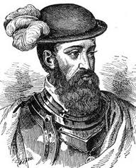
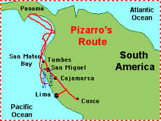
Who were the Spanish Conquistadors?
Other people from Spain who sought gold and riches from Mexico and Central America.
These people who settled and searched for new conquests were called conquistadors.

Slide 21
Conquistadors
How did Cortez conquer the Aztecs?
In 1519 the Aztec leader Montezuma and his people thought that the explorers were gods and were intimidated by their technology (guns, armor, horses).
Cortez was the leader from Spain who was invited to the Aztec capital Tenochtitlan.
He took control of the city and held their leader prisoner.
The mighty Aztec kingdom was eventually destroyed by the conquistadors and their allies.

Slide 22
Conquistadors
How did Pizarro conquer the Incas?
In 1532 Pizarro was interested in the Incan Empire and their riches.
He sailed south along the South American border and eventually found and conquered the Inca Empire.
By 1535, Pizarro controlled and destroyed much of the Incan empire.

Slide 23
Why were the Spanish victorious?
They had superior military equipment like armor and guns.
The horses were also an advantage because the Native Americans had never seen them before.
Aztecs and Incas were intimidated by the Europeans.
They thought the Europeans were possible gods.
The Incas were weak because of the fighting they had within their own empire.
European diseases eventually destroyed much of the Indian population.

Slide 24
Conquistadors
http://www.brainpop.com/socialstudies/worldhistory/conquistadors/

Slide 25
Columbian Exchange
Definition – The term used to describe the enormous widespread exchange of plants, animals, food, diseases, people (including slaves) and ideas between the Old World and New World that occurred after Columbus’ discovery of the New World.
New World Western Hemisphere (Americas)
Old World Eastern Hemisphere (Europe)

Slide 26
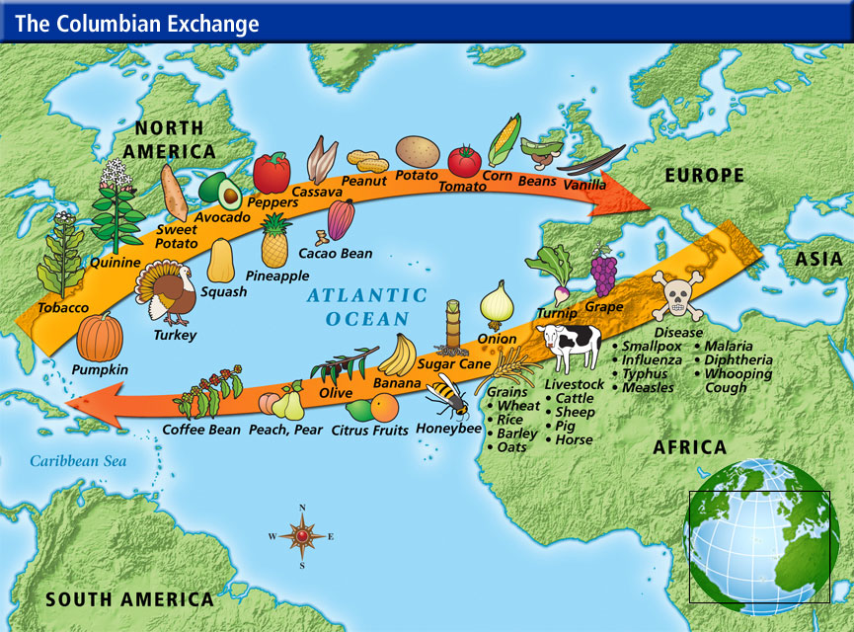

Slide 27
Impact of Columbian Exchange
The discovery of goods in the Americas contributed to the exploration and eventual colonization of the “New World”
Through global interaction, cultures were exposed to new ideas and technologies which led to an exchange and transformation of traditions.
Beginnings of Globalization….

Slide 28
Columbian Exchange
http://www.brainpop.com/socialstudies/worldhistory/columbianexchange/

